Slide 1


A network of choice neurons
By: Ole Bialas, Jochem van Kempen, Robin Gutzen, Pui-Shee Lee, Elisa Buchberger, Charlotte Beylier, Marina Bluma
Vermilion-todys / Smol Birbs

Slide 2


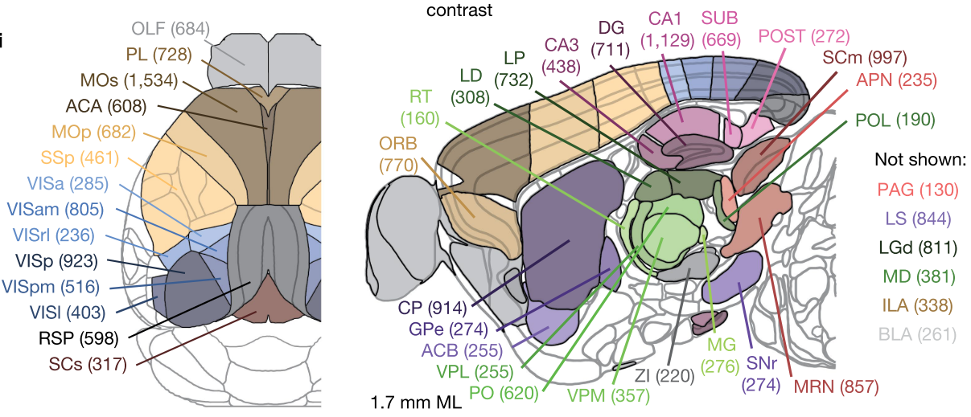
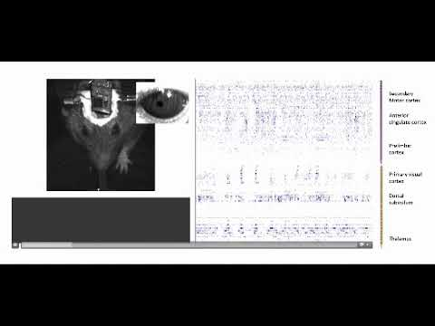
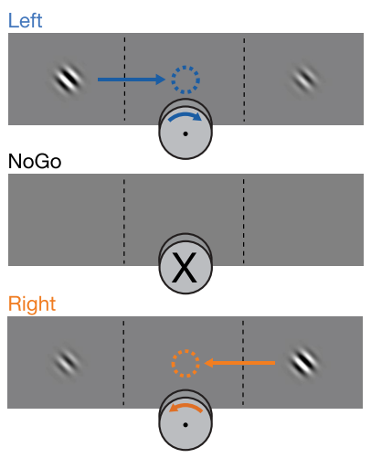
Accepting cookies - A question of firing choice neurons?
Notes:
In everyday life, we have to make choices over and over
Image you visit a website - selecting if you wanna accept or decline cookies.
To study choice behavior in the lab: e.g. rodent studies, visual decision task.
Study by Steinmetz et al → Revealed that activity in rare, spatially distributed so called “choice-neurons” predicts behavior (left/right)
Choice neurons show similarity in firing patterns.
Question: Do choice neurons that are distributed across different brain regions add unique information to the prediction of choice behavior? Or do they carry redundant information.

Slide 3
The process
Extraction of choice neurons using logistic regression
Binary encoding of these neurons
NN model to predict the choice
 | Time 1 | Time 2 | Time 3 | ... | Time N
Cell 1 | 0 | 1 | 0 | 1 | 0
Cell 2 | 1 | 0 | 0 | 0 | 0
Cell 3 | 0 | 0 | 1 | 0 | 1
... | ... | ... | ... | ... | ...
“One-hot encoding”

Slide 4
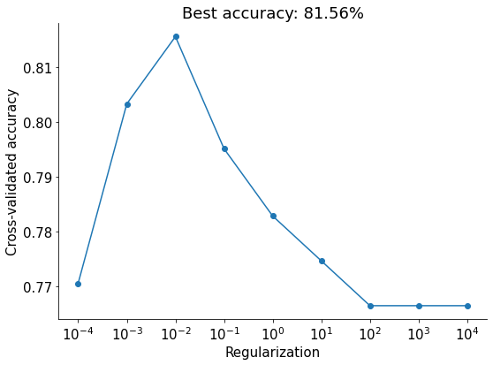
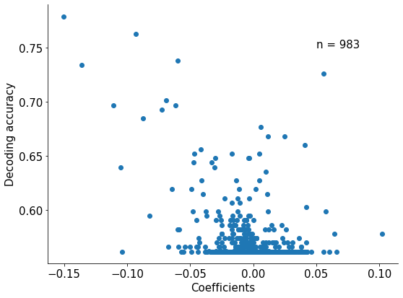
Results - Logistic regression
The choice neurons were identified with logistic regression

Slide 5
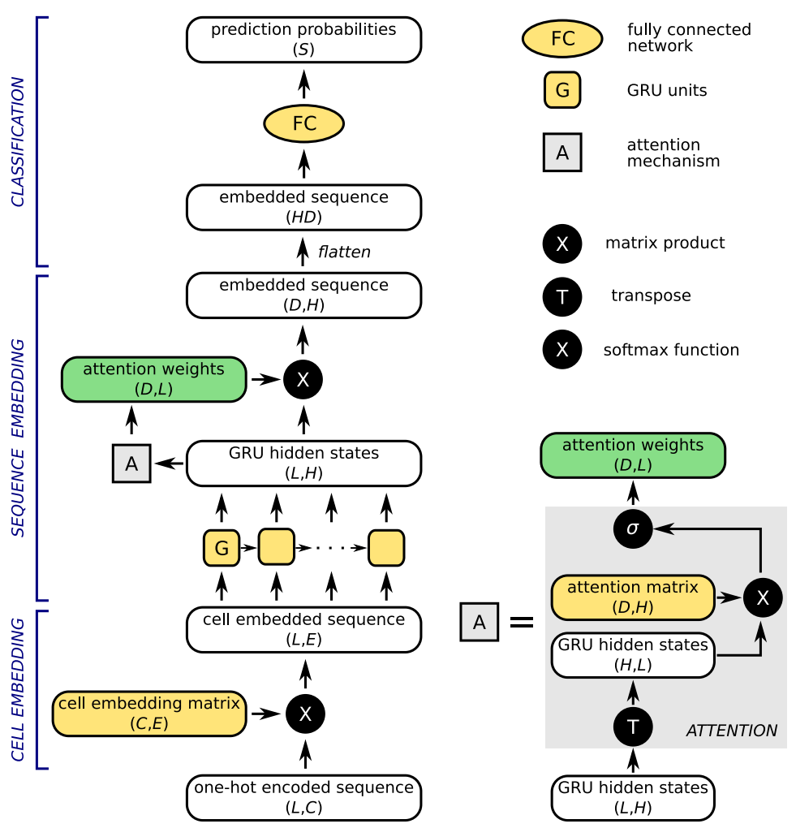
The network architecture
Szabó & Barthó (2020)
L : Length (time)
C : Cells
E : Embedding (50)
H : GRU Hidden units (400)
D : Attention embedding (32)
S : Behavioral choice (2)
Other parameters used:
Adam optimizer
Cross entropy loss
adapted from Szabó & Barthó, 2020

Slide 6
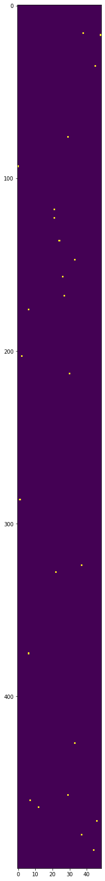
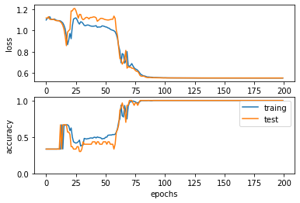
Network predictions on simulated data

Slide 7
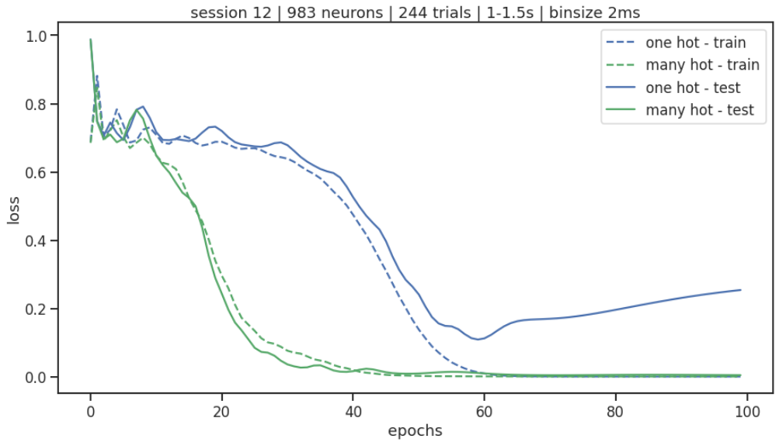
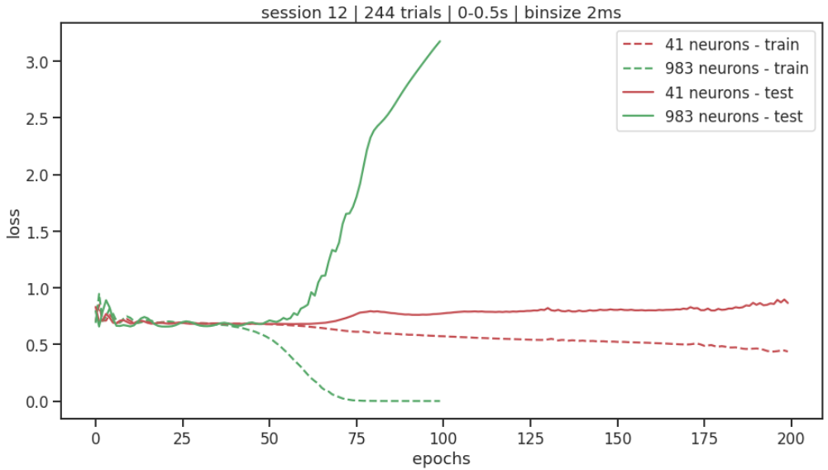
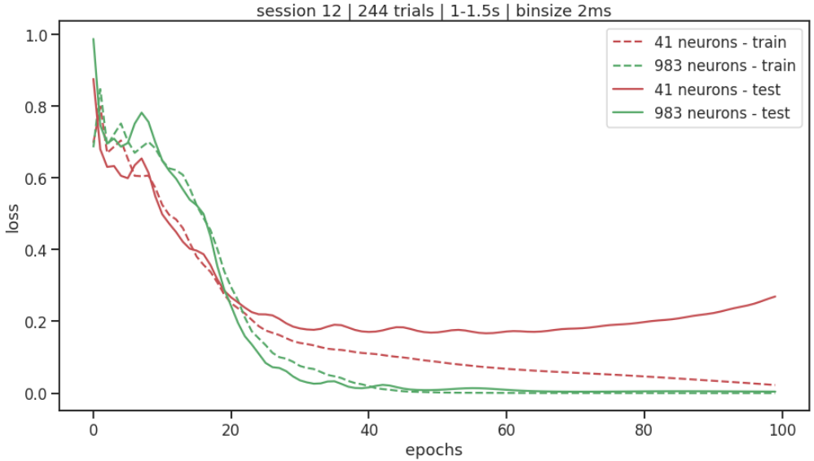
Network predictions on real data
choice neurons ~ full population
movement period is more predictive
many-hot encoding > one-hot encoding
~before movement
~during movement

Slide 8
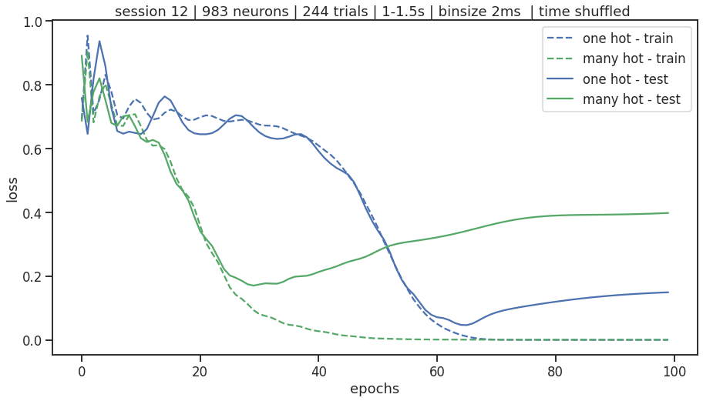
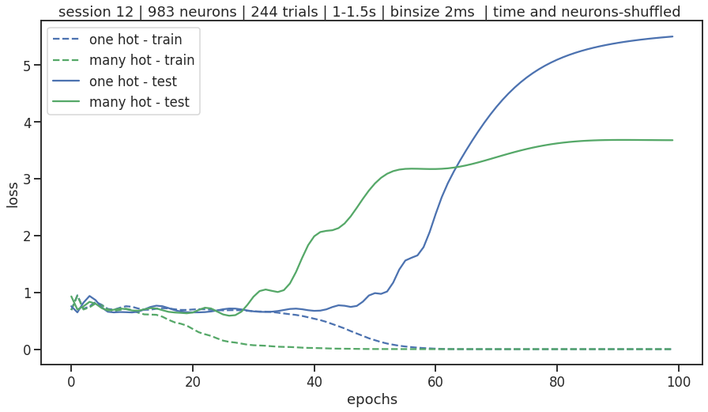
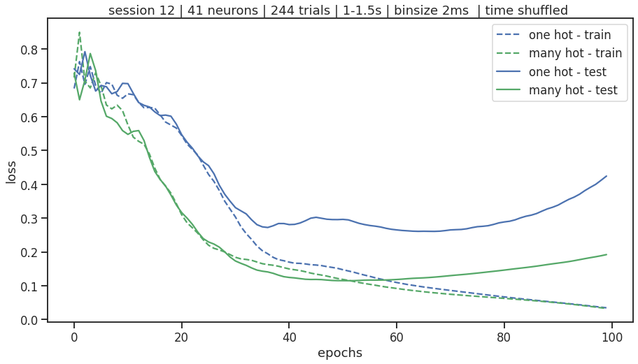
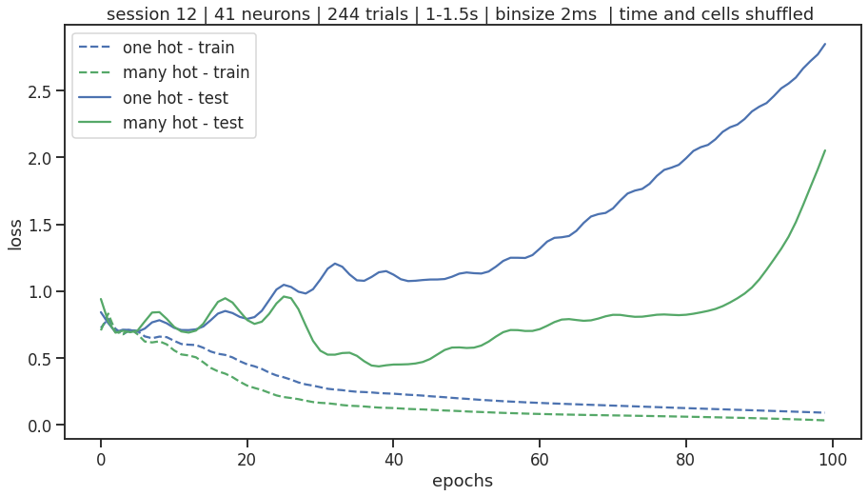
Network predictions on real data
Time-shuffled data
Time-and-cells shuffled data
all neurons
choice neurons

Slide 9

Thanks to…
… our amazing TA Anoop & project TA Hojjat
… our wonderful pod the vermilion todys
… and all of you for your interest!

Slide 10
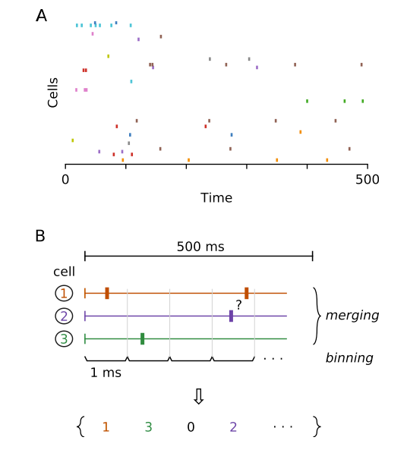
What is one-hot encoding for timeseries data?
Step 1: Integer encoding - mapping of categorical values to integers.
Step2: One-Hot Encoding - representing each integer value as a binary vector.
Notes:
Extra mateerial

